Slide 1
Physical Computing

Slide 2
Breadboard

Slide 3
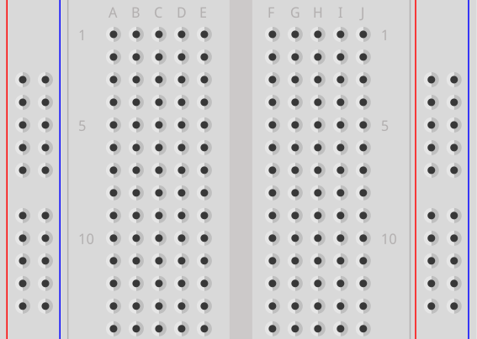
Breadboard
Power rails
Power rails
Terminal strips
Power rails:
Vertical ↕
Terminal strips:
Horizontal ↔
Notes:
Power rails also known as bus strips

Slide 4
Raspberry Pi Pico

Slide 5
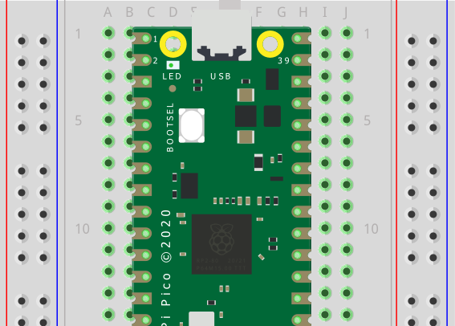
Internal LED
USB connector
LED

Slide 6
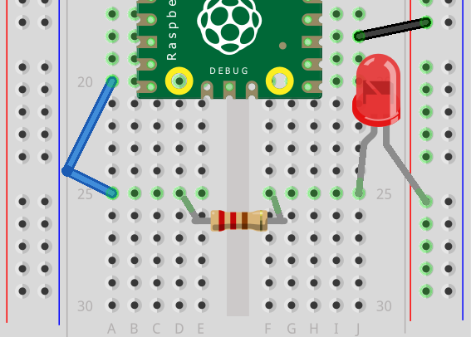
External LED
GND
GP15

